Slide 1

DATABASES AND APPLICATIONS
SUBJECT CODE : UQ23CA653A
Samyukta D Kumta
Computer Applications

Slide 2
DATABASES AND APPLICATIONS
UNIT-IV
Unit 4: Advanced Databases and Database Connectivity
Database Models: - Relation, Network, Hybrid, Hierarchical Model, Object Oriented Model, Non-Relational Database types - Document-oriented, Graph, Key-value, Column-oriented, Advantages of NoSQL over SQL Database, Database Connection – ODBC, JDBC, Database (Connectivity, CRUD Operations)
Experiential Learning: Comparison between various types of database system and non-relational database, Conversion Database into relational, network, hybrid, hierarchical. Conversion Relation Database into non-relational database. Connection of database using MS ACCESS, JAVA, SQL Lite

Slide 3
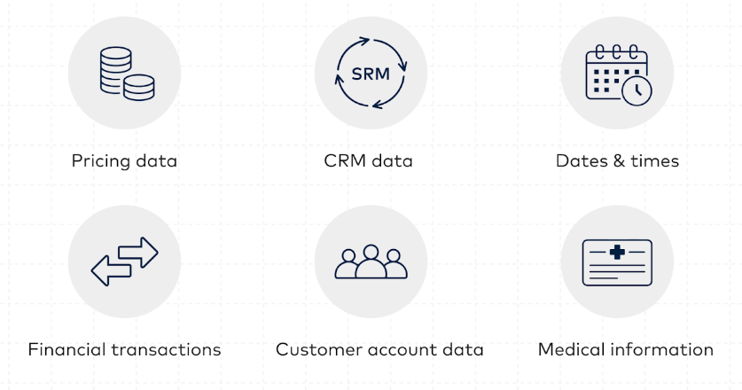
DATABASES AND APPLICATIONS
Advance PL/SQL: Database Models
STRUCTURED DATA

Slide 4
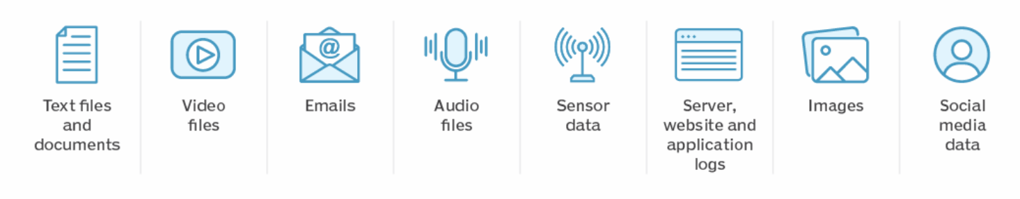
DATABASES AND APPLICATIONS
Advance PL/SQL: Database Models
UNSTRUCTURED DATA

Slide 5
DATABASES AND APPLICATIONS
Advance PL/SQL: Database Models
“Database model” refers to the conceptual framework or structure that defines how data is organized, stored, and manipulated within a database system.
It provides a set of rules and guidelines for representing data and establishing relationships between different pieces of information.
Various database models have been developed over time, each offering different ways to structure and access data.
Relational and Non-Relational data models are two broad categories that represent different approaches to structuring and storing data in databases

Slide 6
DATABASES AND APPLICATIONS
Advance PL/SQL: Database Models
Relational Data Model
Structure
Language
ACID Properties
Schema
Non Relational Data Model
Structure
Flexibility
Scalability

Slide 7
DATABASES AND APPLICATIONS
Advance PL/SQL: Database Models
Relational Data Model:
Structure: The relational data model organizes data into tables, where each table consists of rows (tuples) and columns (attributes). Tables are related to each other through keys.
Language: SQL (Structured Query Language) is the standard language used to interact with relational databases. It provides a set of commands for querying, updating, and managing data.

Slide 8
DATABASES AND APPLICATIONS
Advance PL/SQL: Database Models
Relational Data Model
ACID Properties: Relational databases typically adhere to the ACID (Atomicity, Consistency, Isolation, Durability) properties, ensuring data integrity and reliability.
Schema: Relational databases have a fixed schema, meaning the structure of the data is predefined and enforced by the database management system (DBMS). Changes to the schema can require careful planning and migration.
Examples: MySQL, PostgreSQL, Oracle Database, SQL Server.

Slide 9
DATABASES AND APPLICATIONS
Advance PL/SQL: Database Models
Non-Relational Data Model
Structure: Non-relational databases use various data models such as document-based, key-value pairs, column-family, or graph-based structures. These models offer more flexibility in data representation and organization compared to the tabular structure of relational databases.(JSON format, It stands for JavaScript Object Notation)
Schema: NoSQL databases often have a flexible schema, allowing for dynamic changes to data structure without requiring a predefined schema. This flexibility is useful for handling unstructured or semi-structured data.

Slide 10
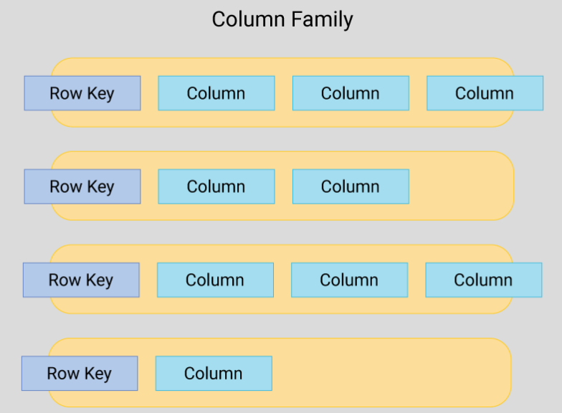
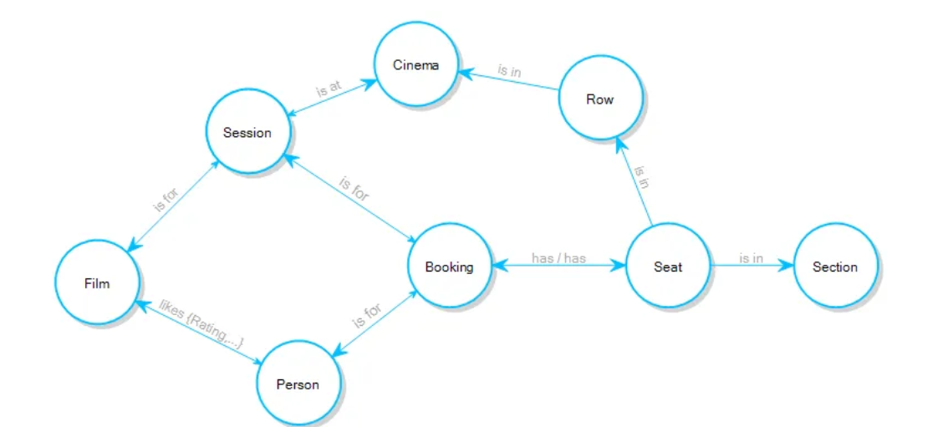
DATABASES AND APPLICATIONS
Advance PL/SQL: Database Models

Slide 11
DATABASES AND APPLICATIONS
Advance PL/SQL: Database Models
Non-Relational Data Model
Query Language: NoSQL databases may use query languages specific to their data model, but they often lack the rich querying capabilities of SQL. Some NoSQL databases support secondary indexes or ad-hoc querying(an unscheduled data query), while others focus on simple CRUD (Create, Read, Update, Delete) operations.
Example:MangoDB,Cassandra,Redis,AmazonDynamoDB,Apache CouchDB,Neo4j

Slide 12
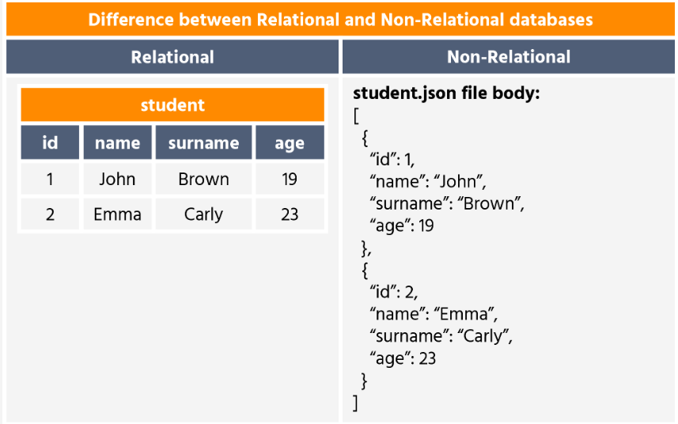
DATABASES AND APPLICATIONS
Advance PL/SQL: Database Models

Slide 13
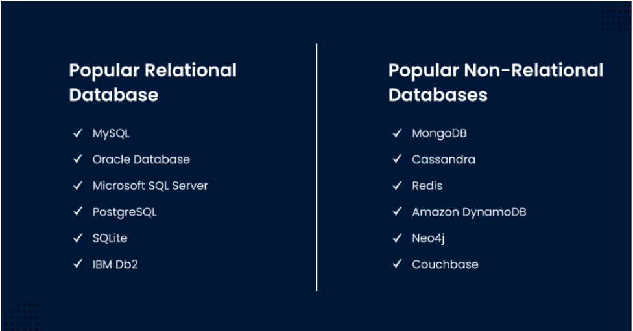
DATABASES AND APPLICATIONS
Advance PL/SQL: Database Models

Slide 14
DATABASES AND APPLICATIONS
Advance PL/SQL: Database Models
The choice between relational and non-relational databases depends on various factors such as the nature of the data, scalability requirements, performance considerations, and the complexity of the application.
Relational databases are well-suited for applications with structured data and complex queries.
Non-relational databases excel in scenarios requiring flexibility, scalability, and handling of diverse data types.

Slide 15

THANK YOU
Samyukta D Kumta
Department of Computer Applications
samyuktad@pes.edu

